Slide 1
Introduction to Gaussian Processes
Michael Kuhn
La Serena School for Data Science
www.aura-o.aura-astronomy.org/winter_school/
2018

Slide 2
Nonparametric Statistics
Useful for modeling complex data where the model form is not known
Disadvantage that these models can be harder to interpret
Examples of nonparametric statistics:
  Histograms
  Kernel density estimation
Commonly used nonparametric regression methods:
  Gaussian processes
  Splines
  Lowess
  Kernel smoothing

Slide 3
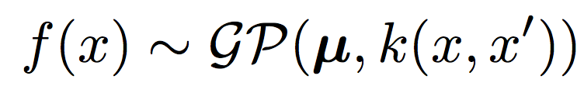
Gaussian Process
“A Gaussian process is a collection of random variables with the property that the joint distribution of any finite subset is a Gaussian. “

Slide 4
Bayesian Perspective
The Gaussian distribution can be thought of as a prior over functions (rather than over parameters)
Distribution is updated by conditioning on the data
Advantage because “fitting” a Gaussian process automatically gives not only the mean but the variance at each point

Slide 5
Objectives for this Lesson
Gaussian processes
  Understand how to use a Gaussian distribution to perform nonparametric regression
Review
  Multivariate normal (Gaussian) distributions
  Covariance matrices
  Marginalization and conditional distributions
  Log-likelihood
  Bayesian (hyper)parameter estimation

Slide 6

Gaussian Distribution
Location parameter μ
Standard deviation σ or covariance matrix Σ

Slide 7
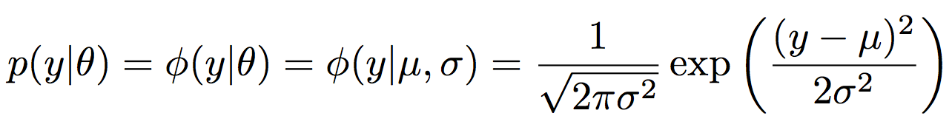
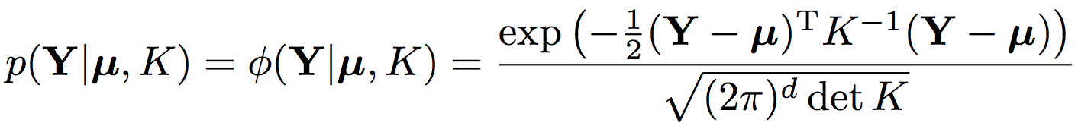
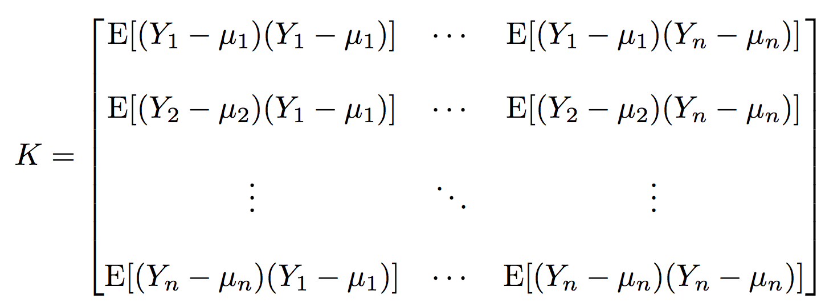
Gaussian Distribution
Single variable Gaussian distribution
Multivariate Gaussian distribution
Covariance matrix

Slide 8

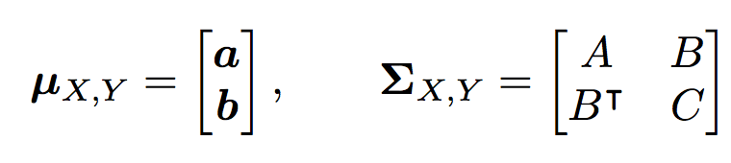


Properties of the Gaussian
joint
marginal
joint
conditional
Marginalization
Conditional Distribution
and

Slide 9
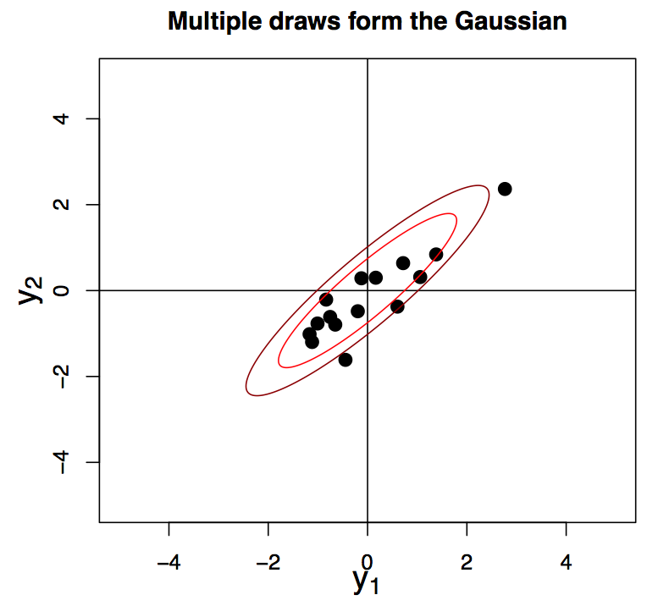
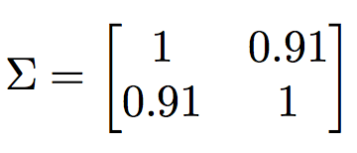
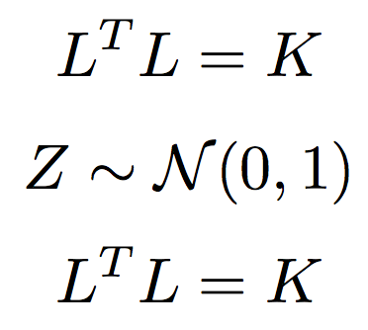
Drawing points from a Gaussian distribution
Several methods
Cholesky factorization of K

Slide 10
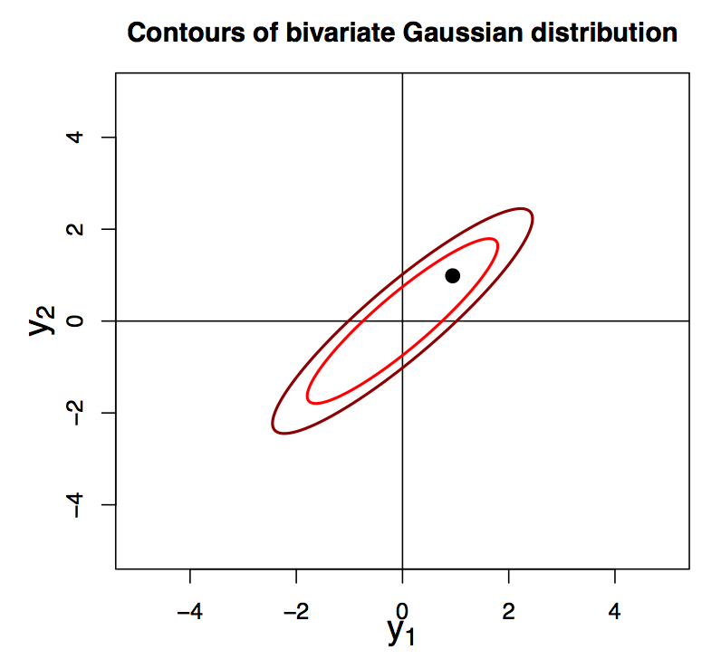
Simple Gaussian Process

Slide 11
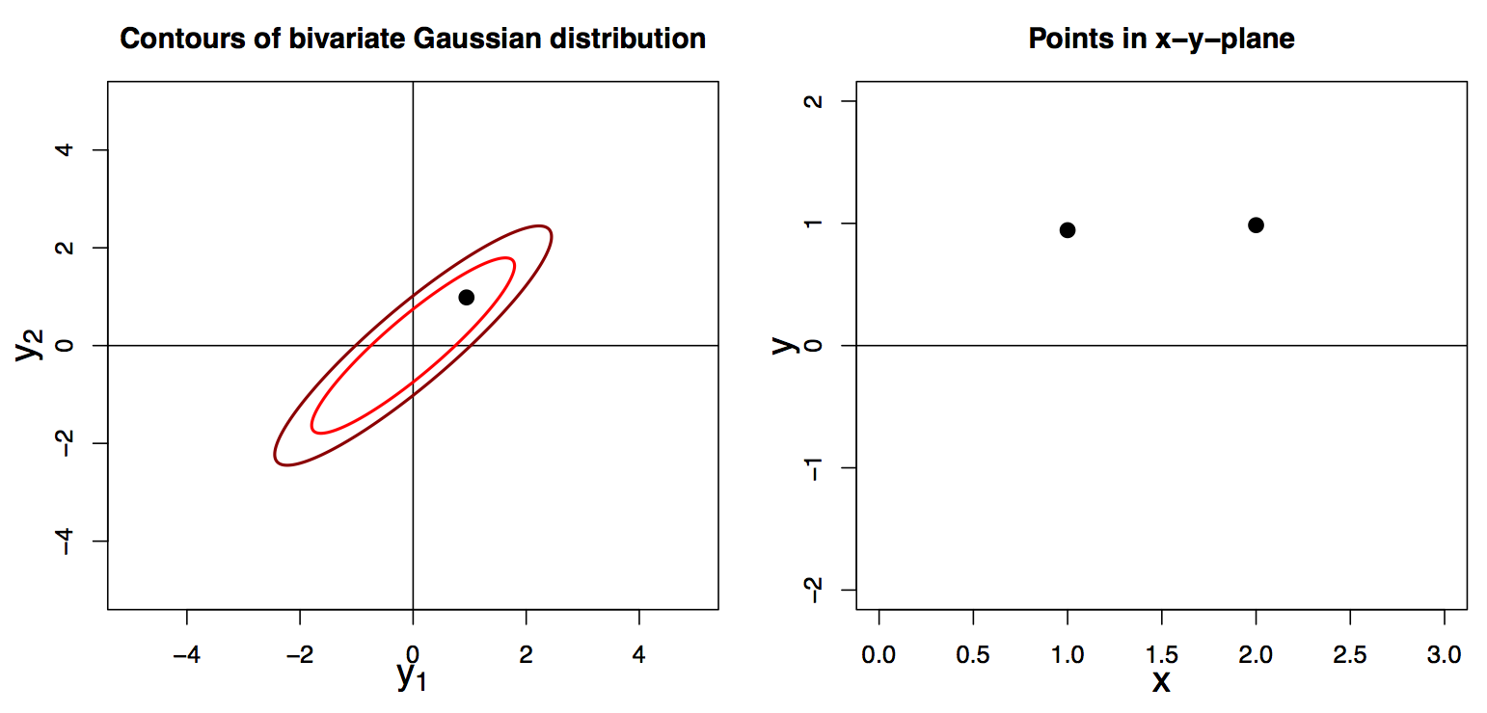
New Representation

Slide 12
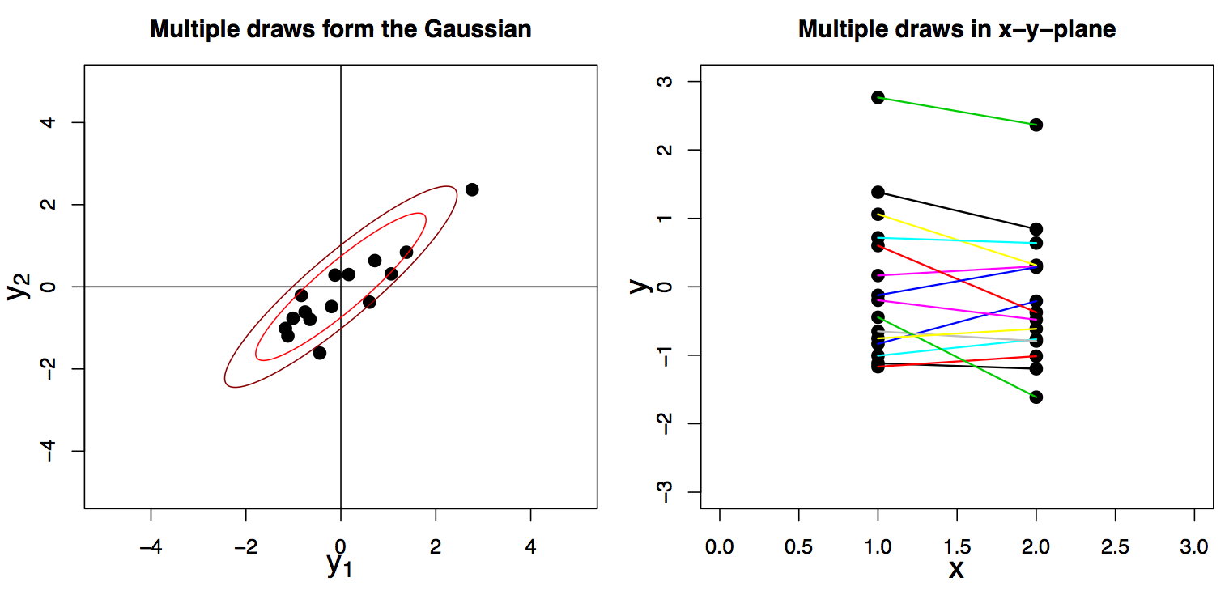
Multiple Draws

Slide 13
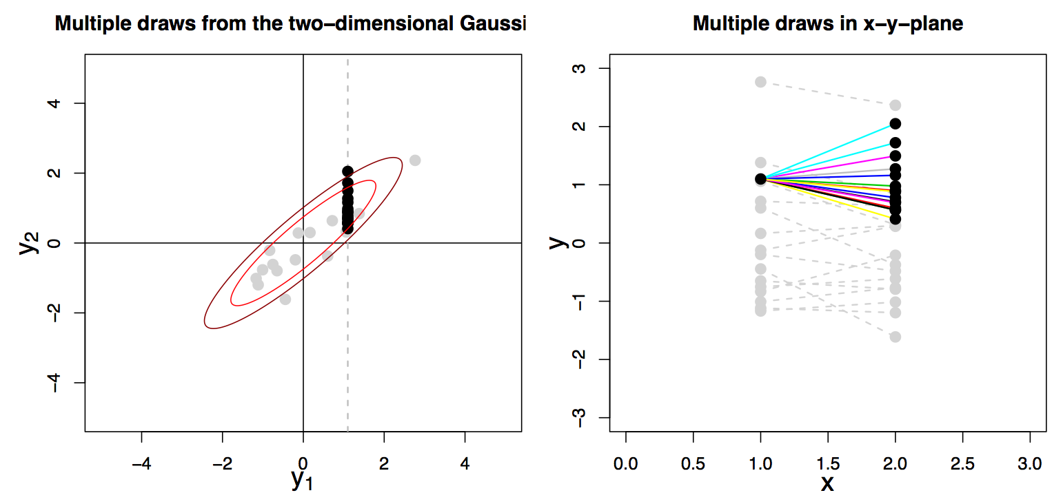
Conditional Distribution

Slide 14
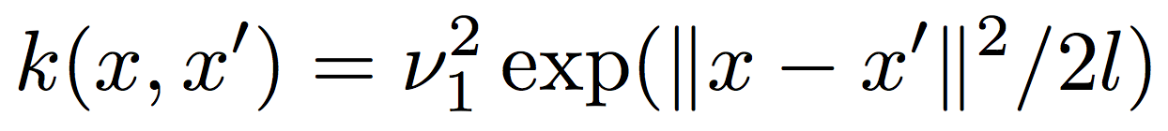
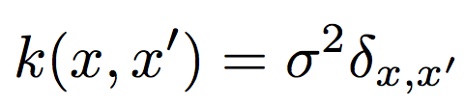
Kernel Function
In general we are interested in Gaussian processes with more than 2 points
The kernel k(x,x’) gives the covariance of pairs of y values as a function of x values
  If k(x,x’) = k(|x-x’|) a kernel is said to be stationary
  The “squared exponential” kernel is the most commonly used for interpolating smooth functions
  The effects of measurement error can be added with the kernel

Slide 15
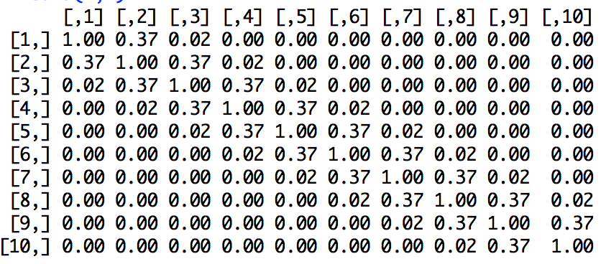
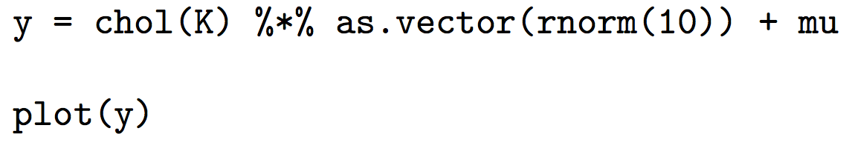
Higher Dimensional Gaussians
K =

Slide 16
Try the sample code for drawing from a Gaussian process

Slide 17
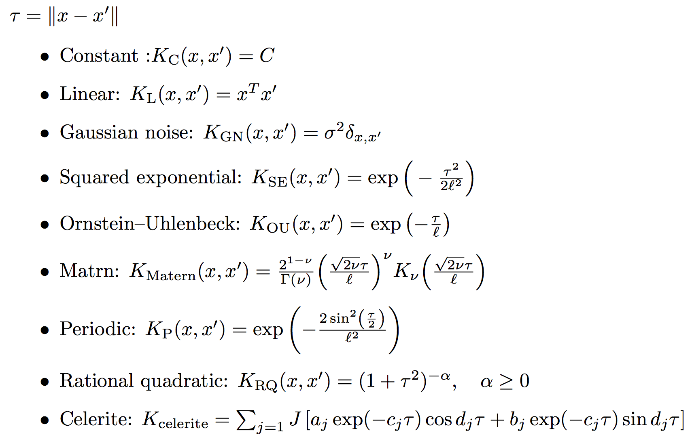
Other kernel functions

Slide 18
Ornstein–Uhlenbeck process

Slide 19
Inference with a Gaussian Process
For a given kernel k(x,x’) there the mean and the variance of the posterior distribution can be found with matrix algebra
Note that even if the mean of a Gaussian process is zero, the mean of the posterior can be non-zero
We do not need to integrate over parameter distributions to find the variance of the function

Slide 20
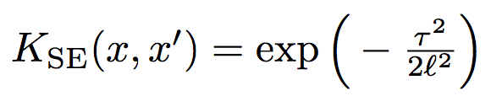
Hyperparameters
l=1, σ=0.001
l=0.3, σ=0.001
Parameters in the mean μ(x) and kernel k(x,x’) are known as hyperparameters
For example, for the squared exponential the length scale l is a hyperparameter

Slide 21
Likelihood
Can you spot any potential computational problems dealing with this quantity?

Slide 22
Try the sample code for fitting a GP

Slide 23
Useful Equations
Conditional Distribution
Log likelihood

Slide 24
Answers

Slide 25
Answers
l=1, σ=0.001
l=1, σ=0.3
l=0.3, σ=0.001

Slide 26
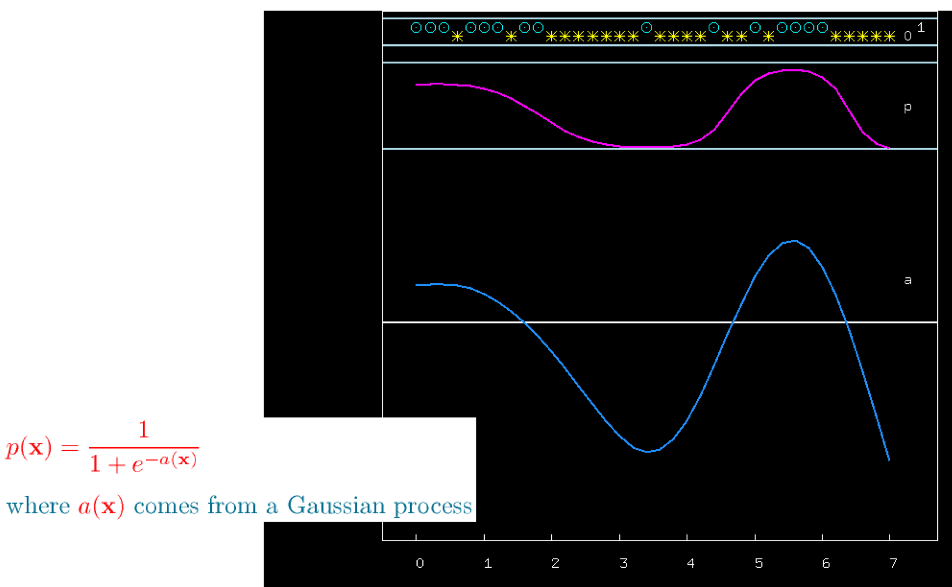
Binary Classifier
Model a latent function f(x) with a Gaussian process
Put f(x) through the sigmoid function
(Credit: David MacKay)

Slide 27
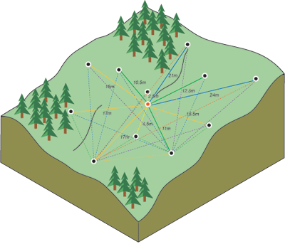
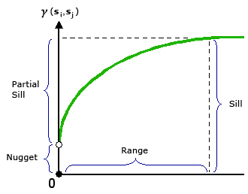
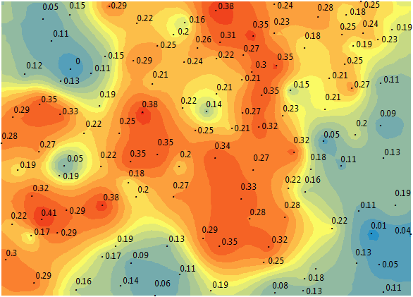
Geostatistics
Gaussian processes have been used for a long time
Known as kriging
Developed by Danie Krige in the 1960s
GeoR in CRAN
(Credit: ArcGIS)
(Credit: GIS Geography)

Slide 28
Celerite
Fast Gaussian Processes code from Foreman-Mackey et al. (2017)
Restrictions of kernel make solving K⁻¹ and det K easy
Turn O(n³) operations into O(n)
Several versions of this kernel have been examined in astronomical contexts
  Rybicki & Press (1995); Kelly (2011); Ambikasaran (2015)
This kernel may be particularly useful for stars with quasiperiodic behavior

Slide 29
If time permits, go to the Python jupyter notebook for celerite.
https://celerite.readthedocs.io/en/stable/

Slide 30
Resources
Textbooks
  Rasmussen & Williams (2006; www.gaussianprocess.org/gpml/)
  MacKay (2003; www.inference.phy.cam.ac.uk/mackay)
Useful python packages
  GPy
  pyGP
  GPflow
  celerite (Foreman-Mackey et al. 2017)
  George (Foreman-Mackey 2015)
  scikit-learn
CRAN packages (https://cran.r-project.org)
  mlegp
  GauPro
  GPfit

